Slide 1
Simulation of forced convection heat transfer in flow across a cylinder in OpenFOAM and verification of Churchill and Bernstein correlation
Project Presentation

Slide 2
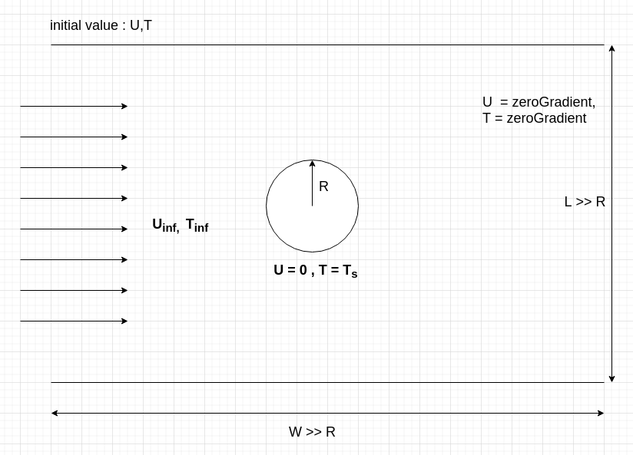
OVERVIEW:
In this project, we have to simulate the crossflow across cylinder with constant temperature and perform the verification of simulation results using Churchill and Bernstein correlation.

Slide 3
Mathematical Modelling:
Conservation of mass for incompressible mass
∇⋅(u) = 0
Conservation of momentum neglecting natural convection(g=0)
ρ(u· ∇ u) = − ∇ · p + ∇·τ
Conservation of energy
ρ(u· ∇ h+u· ∇ e ) = ∂p/∂t + ∇ ·(κ ∇ T) + ∇ ·(τ ·u)
Fluid is considered as perfect gas
pV = nRT h = cpT

Slide 4
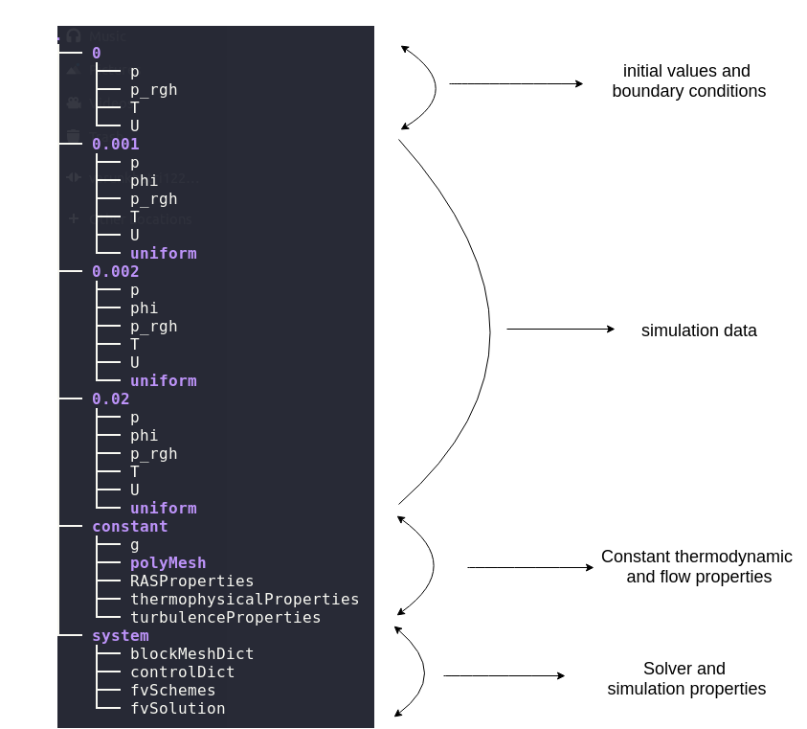
OpenFOAM File System

Slide 5
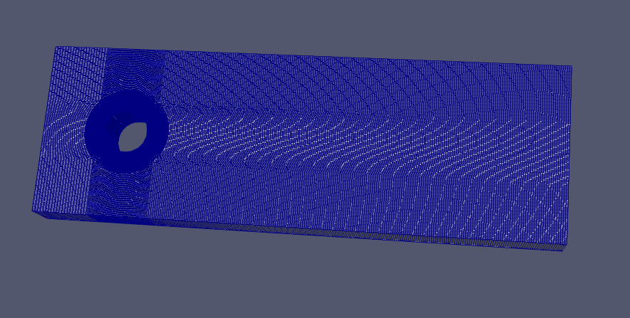
MESH
Salome
blockMesh
Ansys or Comsol

Slide 6
Boundary Conditions & Initial Values
Velocity
inlet: fixedValue
outlet: zeroGradient
Cylinder Wall: 0
Pressure
inlet: fixedValue
outlet: zeroGradient
Cylinder Wall: zeroGradient
Temperature
inlet: fixedValue
outlet: zeroGradient
Cylinder Wall: fixedValue
Initial Values: pressure, temperature, velocity

Slide 7
Assumptions
Steady-state conditions
Incompressible flow
Newtonian Fluid
Perfect gas
Constant thermophysical properties
Negligible radiation effects

Slide 8
Thermophysical Properties
These properties are constant and their values are taken at film temperature.
rho
mu
cp
k
Pr
We have used air as fluid and consider it as ideal gas for all temperatures.

Slide 9
Solver
buoyantSimpleFoam - it is a heat transfer solver in OpenFOAM.
We have used this solver by putting appropriate boundary and initial conditions and making correct approximations wherever necessary.

Slide 10
Post-Processing
Used paraFOAM and paraView for post processing analysis.
Used python and excel for plotting results

Slide 11
Probes
There are a set of general post-processing functions for sampling data across the domain for graphs and visualisation.
type probes;
libs ("libsampling.so");
writeControl timeStep;
writeInterval 1;
fields (
T
);
probeLocations (
( -0.050001000000000004 0.0 0 ) // theta value 0.0
( -0.0500009238441413 8.726816362328135e-05 0 ) // theta value 0.0017453292519943296
( -0.05000069537679718 0.00017453606141260185 0 ) // theta value 0.003490658503988659
( -0.05000031459866359 0.00026180342753481047 0 ) // theta value 0.005235987755982989
( -0.04999978151090045 0.0003490699961583756 0 ) // theta value 0.006981317007977318
( -0.04999909611513163 0.00043633550145419516 0 ) // theta value 0.008726646259971648
( -0.049998258413444976 0.000523599677596406 0 ) // theta value 0.010471975511965978
----
----
)
Points are generated using custom generate_points.py script

Slide 12
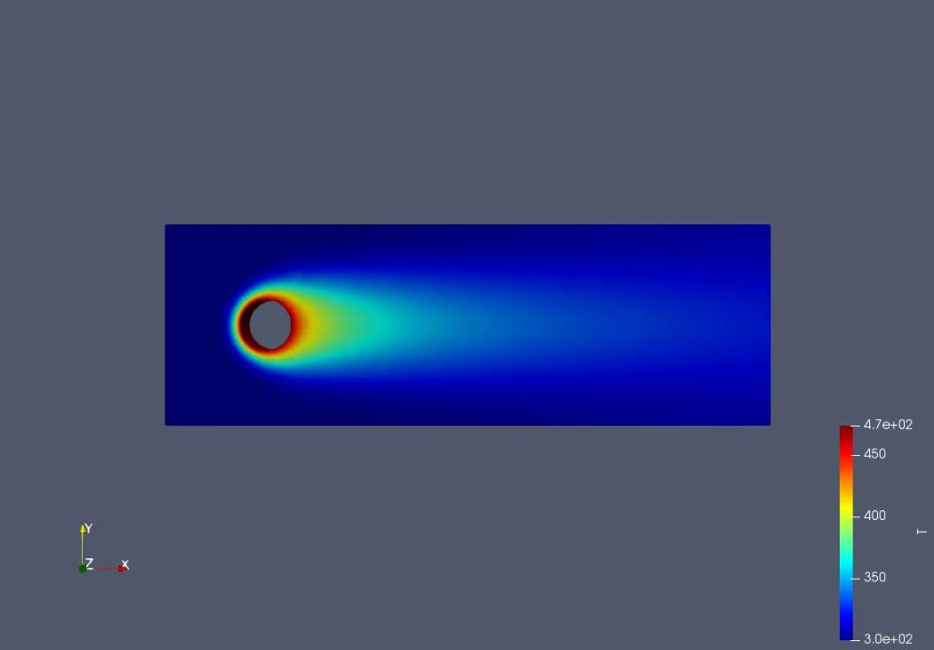

Simulation Result
Re = 21682.71
Pr = 0.711
Duration - 10 ms
Temperature Profile
Velocity Profile

Slide 13
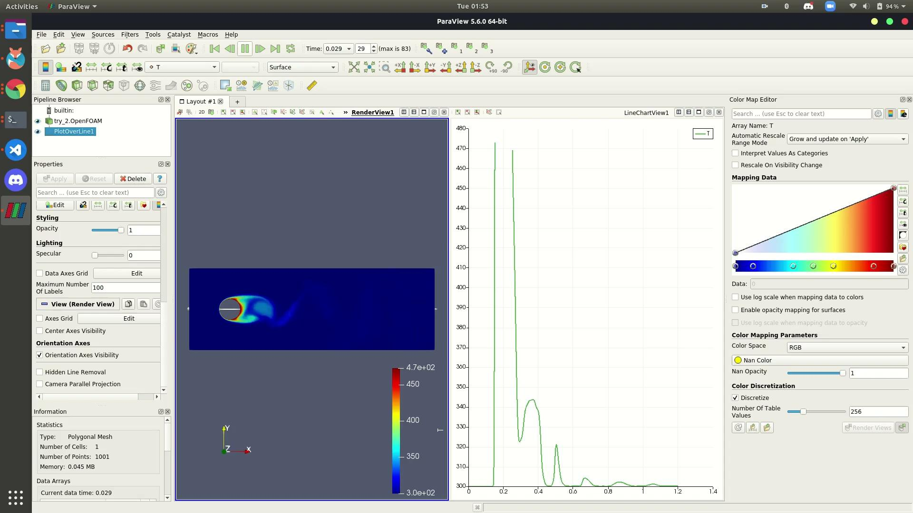
VARIATION OF TEMPERATURE ALONG THE X-AXIS
Pr - 0.6878
Re - 140.90
Duration - 83ms

Slide 14
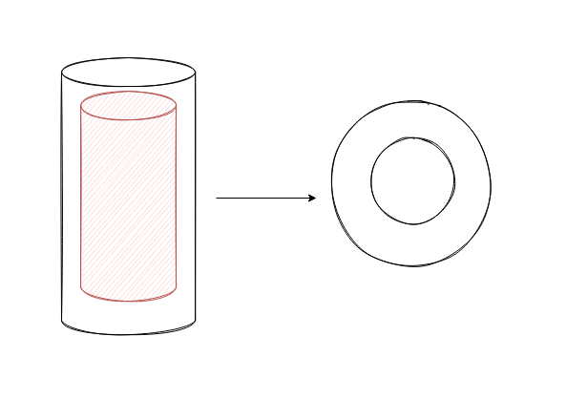
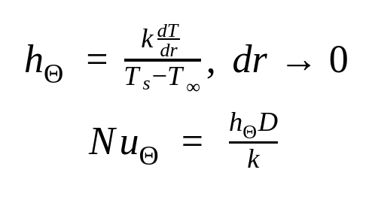
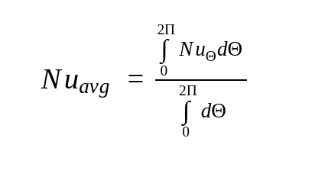
Local Heat Transfer Coefficient

Slide 15
Pseudo Code
ThermalPoint points[];
for Θ in range(0,0.1,2𝚷):
ThermalPoint localPoint;
localPoint.x = -(r+δr)cos(Θ);
localPoint.y = (r+δr)sin(Θ);
localPoint.theta = Θ;
localPoint.z = z₀;
localPoint.temp = field.getTemperature(localPoint.x,localPoint.y,localPoint.z);
localPoint.k = fluidProperties.getConductivity(Θ);
localPoint.h = localPoint.k * (T₀ - localPoint.temp) / (δr * (T₀ - T_{inf});
localPoint.Nu = localPoint.h * D / localPoint.k;
points.add(localPoint);
h_avg = Σ points[i].h / Σsize(points);
Nu_avg = Σ points[i].Nu / Σsize(points);

Slide 16
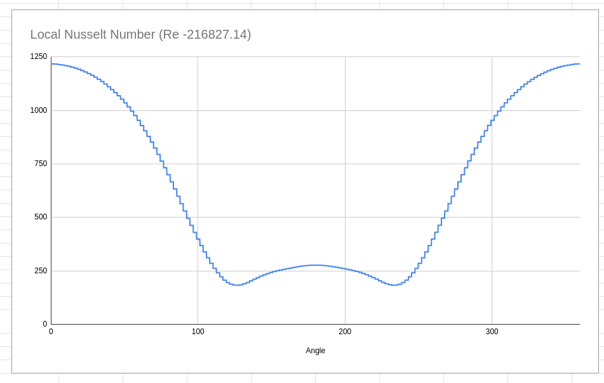
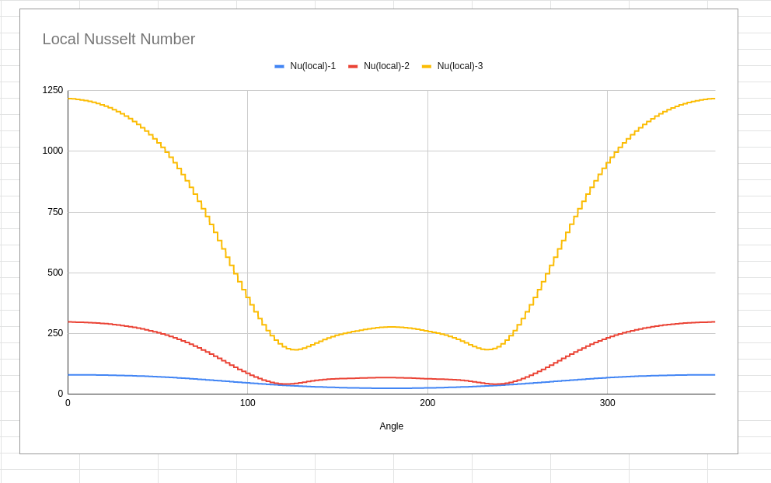
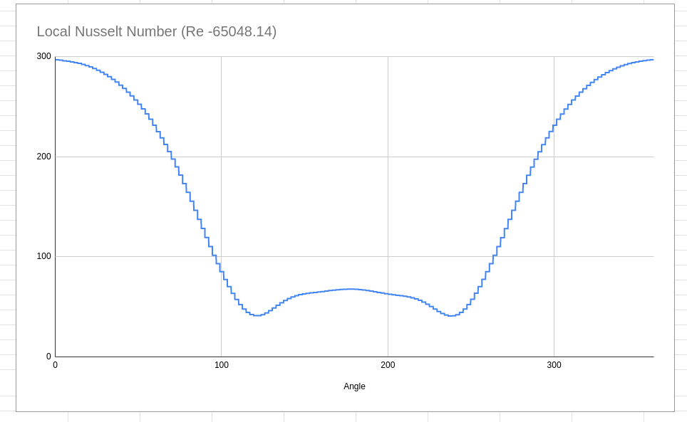
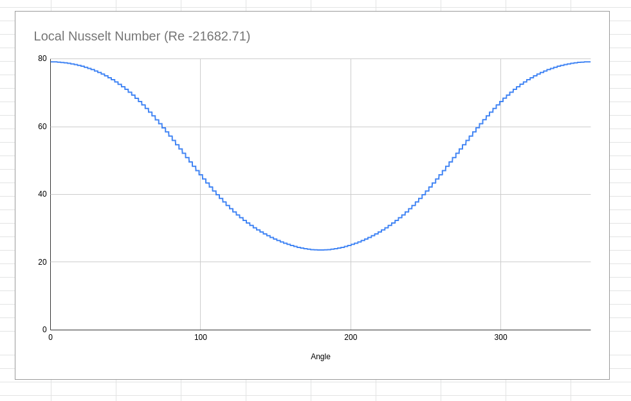
Local Nusselt Number vs Angle

Slide 17
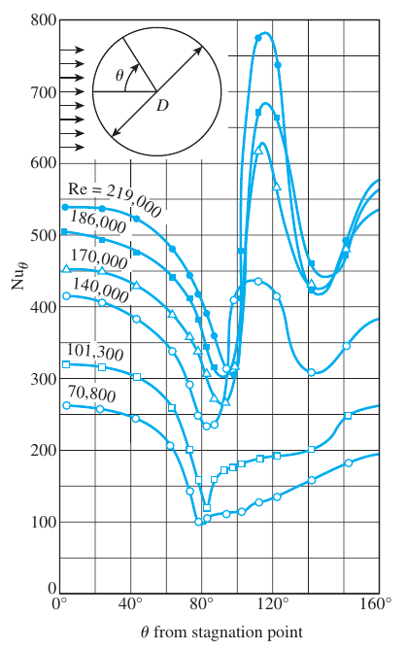
Experimental Data
From cengel heat transfer book

Slide 18
Result
Re | Pr | Nu (OpenFOAM SIMULATION) | Nu (Churchill and Bernstein correlation) | Error
21682.71 | 0.711 | 51.55 | 83.16 | 38.01%
65048.14 | 0.711 | 153.90 | 162.50 | 5.59%
216827.14 | 0.711 | 640.18 | 370.22 | 72.92%

Slide 19
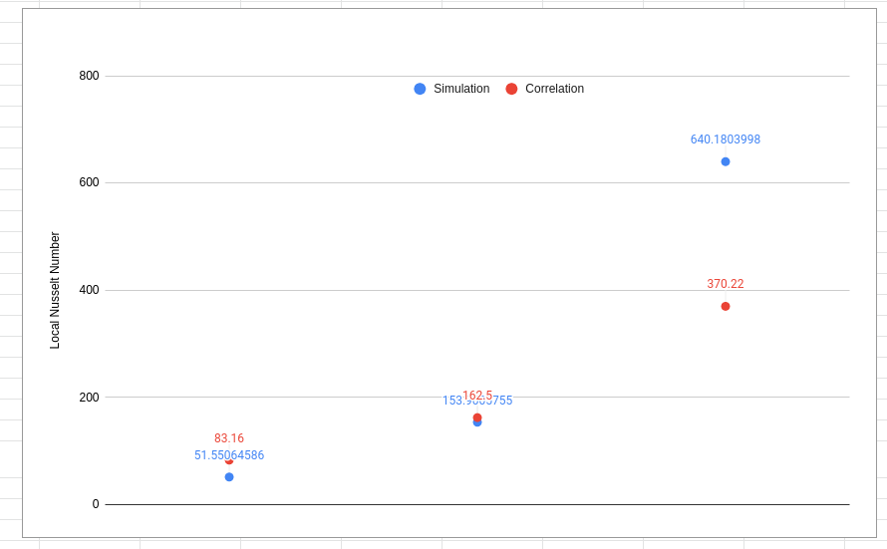
Why Great Mismatch?
Minor errors in code
Steady state not reached
Algorithm is not entirely correct
Maybe correlation is not good

Slide 20
Demo

Slide 21
Future Work
Improve simulation results
Automate post-processing using python and bash scripts
Find value of dT/dr number using second order finite forward differences
Use parallel computation feature of openFoam to reduce computational time
Try other OpenFOAM solvers

Slide 22
References
https://wiki.openfoam.com/Tutorials
https://www.researchgate.net/publication/272088087_Convection_heat_transfer_around_a_single_row_of_cylinders
http://foam.sourceforge.net/docs/Guides-a4/OpenFOAMUserGuide-A4.pdf
https://www.openfoam.com/documentation/guides/latest/doc/guide-applications-solvers-heat-transfer-buoyantSimpleFoam.html
https://www.youtube.com/watch?v=Udt3RhkbgKw&t=1666s
CFD-Online Forum

Slide 23
THANK YOU
ANY QUESTIONS?
code - https://github.com/varunk122/cylinderInCrossflow

